Slide 1
COMP507 IT Project Management Risk Management Daniel

Slide 2
Agenda
The Importance of Project Risk Management
Definition of risk (boils down to a probability/possibility…)
Major risk management processes:
Planning
Identifying
Planning risk responses
Implementing risk responses
Monitoring risk
Notes:
Art and science

Slide 3
The Importance of Project Risk Management (1 of 5)
Project risk management is the art and science of identifying, analyzing, and responding to risk throughout the life of a project and in the best interests of meeting project objectives
Risk management is often overlooked in projects, but it can help improve project success by helping select good projects, determining project scope, and developing realistic estimates
Analogy: a baby does not see risk; an old man sees too much risk…

Slide 4
The Importance of Project Risk Management (4 of 5): what is risk?
A dictionary definition of risk is “the possibility/probability of loss or injury”
General definition of project risk: an uncertainty that can have a negative or positive effect on meeting project objectives
Managing negative risks involves several possible actions that project managers can take to avoid, lessen, change, or accept the potential effects of risks on their projects
Positive risk management is like investing in opportunities
Expected Value plays a role here in deciding if a risk is positive or negative…

Slide 5
Project risk management processes
Planning risk management: deciding how to approach and plan the risk management activities for the project
Identifying risks: determining which risks are likely to affect a project and documenting the characteristics of each
Performing qualitative risk analysis: prioritizing risks based on their probability and impact of occurrence
Performing quantitative risk analysis: numerically estimating the effects of risks on project objectives
Planning risk responses: taking steps to enhance opportunities and reduce threats to meeting project objectives
Implementing risk responses: implementing the risk response plans
Monitoring risk: monitoring identified and residual risks, identifying new risks, carrying out risk response plans, and evaluating the effectiveness of risk strategies throughout the life of the project

Slide 6
Planning Risk Management (1 of 3)
Main output of this process is a risk management plan
Documents the procedures for managing risk throughout a project
The project team should review project documents as well as corporate risk management policies, risk categories, lessons-learned reports from past projects, and templates for creating a risk management plan
It is also important to review the risk tolerances of various stakeholders

Slide 7
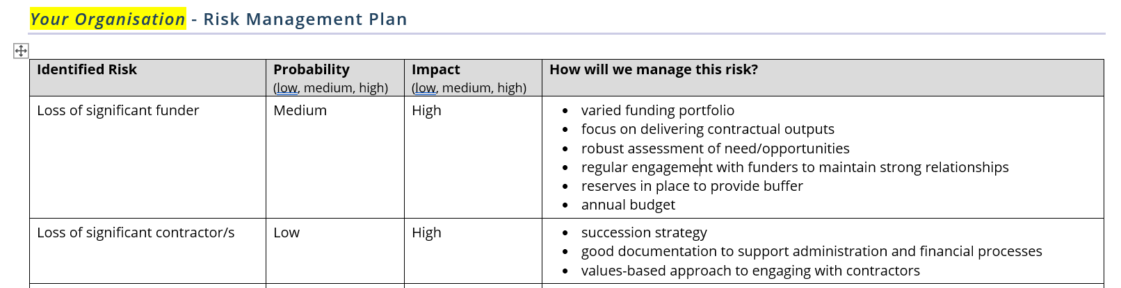
Take a Template Approach
Example Template: https://community.net.nz/resources/nz-navigator-trust/example-risk-management-plan/

Slide 8
Planning Risk Management (2 of 3)
Additional plans
Contingency plans: predefined actions that the project team will take if an identified risk event occurs
Fallback plans: developed for risks that have a high impact on meeting project objectives, and are put into effect if attempts to reduce the risk are not effective
Contingency reserves or allowances: funds included in the cost baseline that can be used to mitigate cost or schedule overruns if known risks occur
Management reserves: funds held for unknown risks that are used for management control purposes

Slide 9
Planning Risk Management (3a of 3)
Topic | Questions to Answer
Methodology | How will risk management be performed on this project? What tools and data sources are available and applicable?
Roles and responsibilities | Which people are responsible for implementing specific tasks and providing deliverables related to risk management?
Budget and schedule | What are the estimated costs and schedules for performing risk-related activities?
Risk categories | What are the main categories of risks that should be addressed on this project? Is there a risk breakdown structure for the project? (See the information on risk breakdown structures later in this chapter.)
Risk probability and impact | How will the probabilities and impacts of risk items be assessed? What scoring and interpretation methods will be used for the qualitative and quantitative analysis of risks? How will the probability and impact matrix be developed?
Revised stakeholders’ tolerances | Have stakeholders’ tolerances for risk changed? How will those changes affect the project?
Tracking | How will the team track risk management activities? How will lessons learned be documented and shared? How will risk management processes be audited?
Risk documentation | What reporting formats and processes will be used for risk management activities?

Slide 10
Planning Risk Management (3b of 3)
Topic | Questions to Answer
Tracking | How will the team track risk management activities? How will lessons learned be documented and shared? How will risk management processes be audited?
Risk documentation | What reporting formats and processes will be used for risk management activities?
Roles and responsibilities | Who owns the risk process? Who owns each risk? Who updates the risk register? Who escalates risks to the sponsor/supervisor?
Risk categories | What categories will be used to organise risks (scope, schedule, cost, quality, people, stakeholder, technical, security/privacy, suppliers)? Will an RBS (Risk Breakdown Structure) be used?
Definitions and thresholds | How will likelihood and impact be defined (Low/Med/High or 1–5)? What thresholds define “High risk”? When does a risk require escalation?
Probability–impact matrix | What matrix will be used to prioritise risks? How will the team calculate risk rating (e.g., likelihood × impact)?
Risk appetite and tolerance | How much risk is acceptable? What risks are “non-negotiable” (e.g., privacy/security)? What trade-offs are allowed between scope, time, and quality?
Review cadence | How often will risks be reviewed (weekly team meeting, weekly mentor meeting)? When will the register be updated? When will risks be re-scored?
Escalation path | When should risks be escalated, and to whom (client sponsor, supervisor, platform/security teams)? What is the escalation timeframe?
Risk response planning | What response strategies will be used (avoid, mitigate, transfer, accept)? How will actions be assigned and scheduled? How will contingency plans be defined?
Risk triggers and early warning signs | What triggers will be recorded for each major risk? How will the team detect early warning signs before risks become issues?
Integration with schedule/WBS | How will mitigation actions be converted into tasks in the WBS/schedule? How will the team track completion of mitigation actions?
Risk-to-issue handover | What happens when a risk occurs? How will it be moved into the issue register? Who updates the issue log and assigns actions?
Tools and templates | What tools will be used (risk register template, issue register template, dashboard, meeting minutes)? Where will risk evidence be stored (portfolio location)?
Metrics and reporting | What metrics will be used (high risks count, overdue actions, risk exposure trend, risks converted to issues)? How will risk status be reported to stakeholders?

Slide 11
Common risk categories/sources (1 of 3)
Several studies show that IT projects share some common sources of risk
The Standish Group developed an IT success potential scoring sheet based on potential risks
Other broad categories of risk help identify potential risks
Market risk
Financial risk
Technology risk
People risk
Structure/process risk
A risk breakdown structure is a hierarchy of potential risk categories for a project

Slide 12
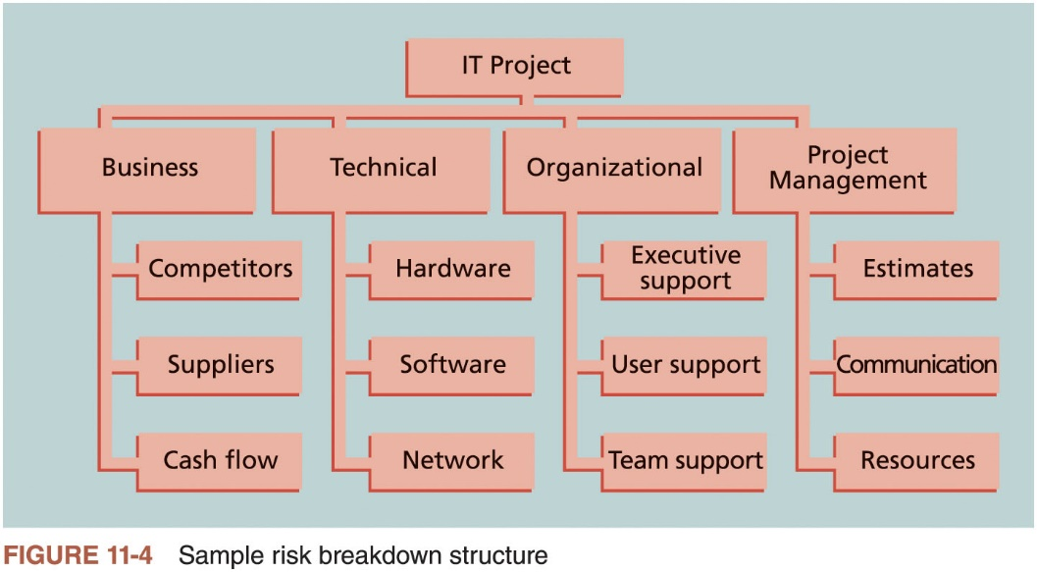
Common risk categories/sources (2 of 3)

Slide 13

Common Sources of Risk in Information Technology Projects
The Standish Group developed an IT success potential scoring sheet based on potential risks

Slide 14
Common risk categories/sources (3 of 3) - ITPM
Knowledge Area | Risk Conditions
Integration | Inadequate planning; poor resource allocation; poor integration management; lack of post-project review
Scope | Poor definition of scope or work packages; incomplete definition
Time | Errors in estimating time or resource availability; errors in determining the critical path; poor allocation and management of float; early release of competitive products
Cost | Estimating errors; inadequate productivity, cost, change, or contingency
Quality | Poor attitude toward quality; substandard design, materials, and workmanship; inadequate quality assurance program
Human resource | Poor conflict management; poor project organization and definition of responsibilities; absence of leadership
Communications | Carelessness in planning or communicating
Risk | Ignoring risk; unclear analysis of risk; poor insurance management
Procurement | Unenforceable conditions or contract clauses; adversarial relations
Stakeholders | Lack of consultation with key stakeholder; poor sponsor engagement
Table 11-3 Potential negative risk conditions associated with each knowledge area

Slide 15
Activity One:University Student Services App
A project team has been asked to develop a Student Services mobile application for a university within 14 weeks. The app will provide timetables, notifications, appointments, and selected academic information. The four-person team has web-development experience but no previous production mobile-development experience. Several university departments have different expectations for the first release, and some requirements may change after student feedback. The app must integrate with two existing systems, but one has incomplete documentation and API access has not yet been approved. The team has chosen a new mobile framework that nobody has used before. One of the strongest developers will also be unavailable for two weeks. The app will handle personal student information, but no security specialist has reviewed the solution. The client has also requested additional features, including push notifications and online payments, without changing the deadline. The team has not yet finalised its testing approach or agreed how often the client will review completed work.
Task: Read the case study and identify the project risks and classify each risk under the appropriate Project Management Knowledge Area using the provided risk conditions table.

Slide 16
Planning Process Group: Identifying Risks
Identifying risks is the process of understanding what potential events might hurt or enhance a particular project
Risk identification tools and techniques include:
Brainstorming- think smash
The Delphi Technique
Interviewing
SWOT analysis

Slide 17
Planning Process Group: Think Smash Workshop
Get the whole team in a room and list everything that could go wrong (or right) across scope, time, cost, quality, people, tools, client, and approvals.
Write down what you’re relying on (client availability, access, tools, skills). Any assumption that might not be true becomes a risk.
Identify gaps in team skills; treat missing capability as a risk and plan upskilling.

Slide 18
Planning Process Group: SWOT analysis
SWOT = Strengths, Weaknesses, Opportunities, Threats (use it to surface risks early).
Strengths (internal positives): What advantages help delivery? (e.g., strong skills, good client access). Risk use: identify strengths you must protect.
Weaknesses (internal negatives): What internal gaps could hurt delivery? (e.g., low skill in a tool, poor availability). These often become risks if not addressed.
Opportunities (external positives): What outside factors could help the project? (e.g., client provides templates, free tool access). Convert to positive risks you can exploit.
Threats (external negatives): What outside factors could block the project? (e.g., delayed approvals, data access limits, stakeholder resistance). These are your major risks.

Slide 19
Planning Process Group: SWOT analysis
SWOT = Strengths, Weaknesses, Opportunities, Threats (use it to surface risks early).
Strengths (internal positives): What advantages help delivery? (e.g., strong skills, good client access). Risk use: identify strengths you must protect.
Weaknesses (internal negatives): What internal gaps could hurt delivery? (e.g., low skill in a tool, poor availability). These often become risks if not addressed.
Opportunities (external positives): What outside factors could help the project? (e.g., client provides templates, free tool access). Convert to positive risks you can exploit.
Threats (external negatives): What outside factors could block the project? (e.g., delayed approvals, data access limits, stakeholder resistance). These are your major risks.

Slide 20
Activity Two:University Student Services App
A student team is developing a mobile app for university student services. The project has strong management support, access to the university IT team, and an early prototype that received positive student feedback. However, the team has limited mobile-development experience, a short 14-week timeframe, and some difficulties integrating with existing university systems. The university sees opportunities to expand the app with more digital services in the future. At the same time, the project may be affected by cybersecurity threats, privacy requirements, and changes in third-party technologies.
Task: Identify at least three items for each dimension of the SWOT analysis

Slide 21
Planning Process Group: Interviews
Interview key stakeholders early (sponsor, client contact, users, IT/platform, privacy/security, mentor).
Ask “What could stop this project from succeeding?” (biggest blockers).
Ask “What usually goes wrong in projects like this?” (past failure patterns).
Ask “What assumptions are we making that might be wrong?” (turn assumptions into risks).
Ask “What approvals, access, or data do we depend on?” (dependency risks).Ask “What would cause delays?” (schedule and availability risks).
Ask “What quality problems do you worry about?” (defects, usability, reliability).
Ask “What privacy/security concerns must we meet?” (compliance risks).
Ask “What does success look like—and what would disappoint you?” (expectation and acceptance risks).

Slide 22
The Risk Register (1 of 4)
Important output of the risk identification process
List of identified risks and other information needed to begin creating a risk register
Risk events refer to specific, uncertain events that may occur to the detriment or enhancement of the project

Slide 23
The Risk Register (2 of 4)
Risk register contents
Identification number for each risk event
Rank for each risk event
Name of each risk event
Description of each risk event
Category under which each risk event falls
Root cause of each risk
Triggers for each risk; indicators or symptoms of actual risk events
Potential responses to each risk
Risk owner or person who will own or take responsibility for each risk
Probability and impact of each risk occurring
Status of each risk

Slide 24
The Risk Register (3 of 4)
No. | Rank | Risk | Description | Category | Root Cause | Triggers | Potential Responses | Risk Owner | Probability | Impact | Status
R44 | 1
R21 | 2
R7 | 3
Table 11-4 Sample risk register

Slide 25
Activity Three: Identify Risks and Develop a Risk Register
A project team has 12 weeks to develop an online booking system for a healthcare organisation. The system will allow customers to create accounts, book and cancel appointments, make online payments, and receive appointment reminders. The client expects the system to be ready before the start of a new service launch. During planning, the team discovers that the client has not finalised the payment requirements, and the project depends on integration with an external payment provider. One developer has limited experience with the selected technology, while another developer is working on two projects at the same time. The client is also frequently unavailable to review completed work and confirm requirements. The system will store personal customer and appointment information, but security and privacy testing have not yet been planned. The team has also not agreed on a backup approach if the external payment integration is delayed or fails.

Slide 26
Performing Qualitative Risk Analysis
Assess the likelihood and impact of identified risks to determine their magnitude and priority
Risk quantification tools and techniques
Probability/impact matrixes
The top ten risk item tracking
Expert judgment

Slide 27
Using Probability/Impact Matrixes to Calculate Risk Factors (1 of 3)
Lists relative probability of a risk occurring on one side of a matrix or axis on a chart and the relative impact of the risk occurring
List the risks and then label each one as high, medium, or low in terms of its probability of occurrence and its impact if it did occur
Calculates risk factors
Numbers that represent the overall risk of specific events based on their probability of occurring and the consequences to the project if they do occur

Slide 28
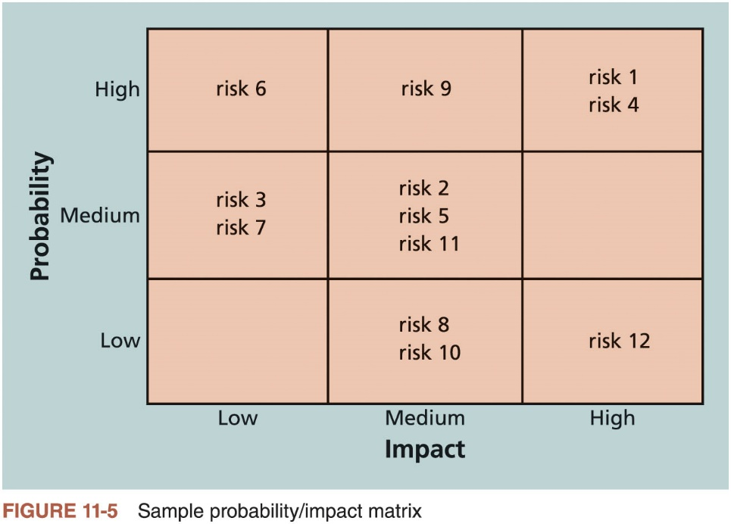
Using Probability/Impact Matrixes to Calculate Risk Factors (2 of 3)

Slide 29
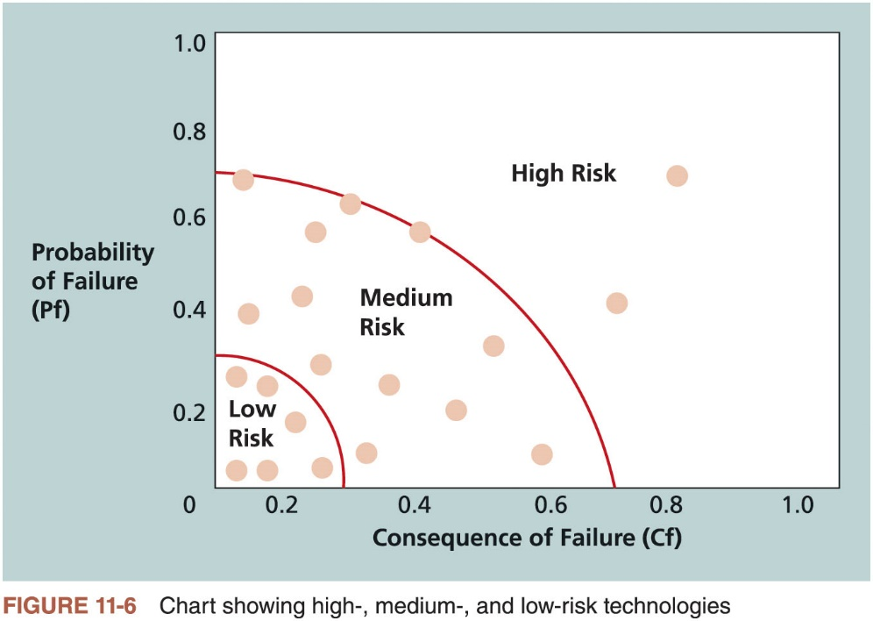
Using Probability/Impact Matrixes to Calculate Risk Factors (3 of 3)

Slide 30

Top Ten Risk Item Tracking (1 of 2)
Qualitative risk analysis tool that helps to identify risks and maintain an awareness of risks throughout the life of a project
Involves establishing a periodic review of the top ten project risk items
Includes the current ranking, previous ranking, number of times the risk appears on the list over a period of time, and a summary of progress made in resolving the risk item
A watch list is a list of risks that are low priority, but are still identified as potential risks
Qualitative analysis can also identify risks that should be evaluated quantitatively

Slide 31
Top Ten Risk Item Tracking (2 of 2)
 | Monthly Ranking | Monthly Ranking | Monthly Ranking
Risk Event | Rank This Month | Rank Last Month | Number of Months in Top Ten | Risk Resolution Progress
Inadequate planning | 1 | 2 | 4 | Working on revising the entire project management plan
Poor definition | 2 | 3 | 3 | Holding meetings with project customer and sponsor to clarify scope
Absence of leadership | 3 | 1 | 2 | Assigned a new project manager to lead the project after the previous one quit
Poor cost estimates | 4 | 4 | 3 | Revising cost estimates
Poor time estimates | 5 | 5 | 3 | Revising schedule estimates
Table 11-5 Example of top ten risk item tracking

Slide 32
Performing Quantitative Risk Analysis
Often follows qualitative risk analysis, but both can be done together
Large, complex projects involving leading edge technologies often require extensive quantitative risk analysis
Main techniques
Decision tree analysis (to calculate expected value)
Simulation
Sensitivity analysis

Slide 33
Decision Trees and Expected Monetary Value (EMV) (1 of 2)
A decision tree is a diagramming analysis technique used to help select the best course of action in situations in which future outcomes are uncertain
Estimated monetary value (EMV) is the product of a risk event probability and the risk event’s monetary value
You can draw a decision tree to help find the EMV

Slide 34
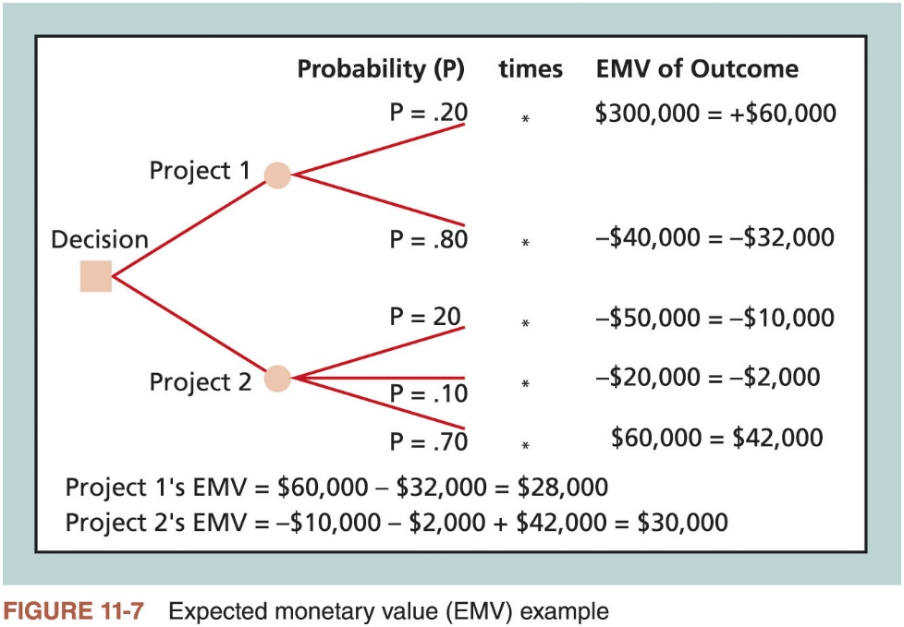
Decision Trees and Expected Monetary Value (EMV) (2 of 2)
A project’s EMV is the expected value of a random var with weighted risk events
A project’s EMV should be equivalent to its contingency reserve: if EMV is positive, then the project has enough money for the risks, otherwise the project needs more money to mitigate the identified risks

Slide 35
Implementation: Risk Response techniques
Owner Assignment (RACI-style clarity) Every key risk response must have one accountable owner who drives it, plus supporting roles if needed.
Weekly Risk Review Meeting (standing agenda item) In team and mentor meetings, review: top risks, what actions were completed, what’s overdue, what triggers are appearing, what must be escalated.
Change Control process (when responses affect baselines)If a risk response changes scope/schedule/tools, raise a change request and update the baseline properly (scope statement, WBS, schedule).

Slide 36
Implementation: Owner Assignment (RACI-style clarity)
RACI = Responsible, Accountable, Consulted, Informed (who does the work, who owns the outcome, who gives input, who gets updates).
One Accountable per deliverable/task (single owner to prevent confusion and blame-shifting).Responsible can be multiple (several people can help do the work, but still report to the one Accountable).
Consulted = two-way communication (get input before decisions; record it).Informed = one-way communication (keep updated after decisions; no approval needed).
Use RACI for high-risk tasks (scope decisions, approvals, privacy/security, tool/hosting access, testing sign-off, handover).
Link RACI to WBS and schedule (every major task/work package has clear R/A/C/I).Reduce meeting confusion by stating
RACI at the start of key meetings (“who decides?” “who owns actions?”).
Update RACI when scope changes (new stakeholders or responsibilities = update roles immediately).
Store RACI in the portfolio and reference it in team contract / stakeholder management plan.

Slide 37
Monitoring of Risk
Risk reassessment (weekly risk review) Re-check the risk list regularly: add new risks, remove irrelevant ones, update likelihood/impact, and re-rank priorities.
Risk audits A structured check that asks: Are we actually doing the planned risk responses? Are they working? Are we tracking the right risks?
Reserve analysis
Check whether your time buffers/contingency reserves are still adequate, and whether they are being used up too early.
Risk response effectiveness checks
For each major risk, confirm whether mitigation actions reduced likelihood/impact. If not, adjust the response plan.

